Slide 1
Hobby Web
Application
Matthew Dunnage

Slide 2
Overview
Approach to the project
Project planning
CI pipeline
The program - demonstration
Reflection

Slide 3
My Approach
Given the task - create a project for a hobby of choice
Link project to a database
My project = web app for creating short stories
Set realistic goals
Started with two entities to achieve the MVP
Ordered goals by difficulty/achievability

Slide 4
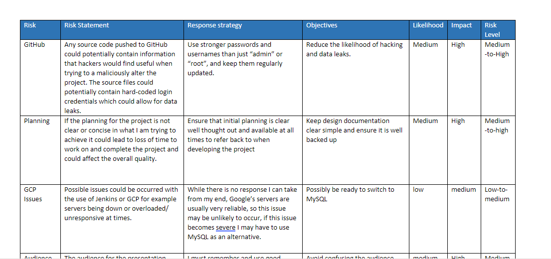
Project Planning - Risk Assessment

Slide 5
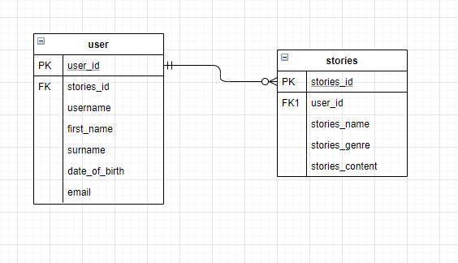
Project Planning - ERD
Two Entities
User & Stories
Possibility of adding more entities in the future

Slide 6
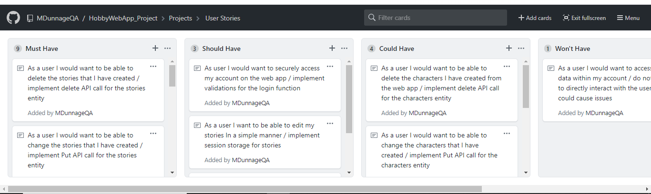
Project Planning - User Stories

Slide 7
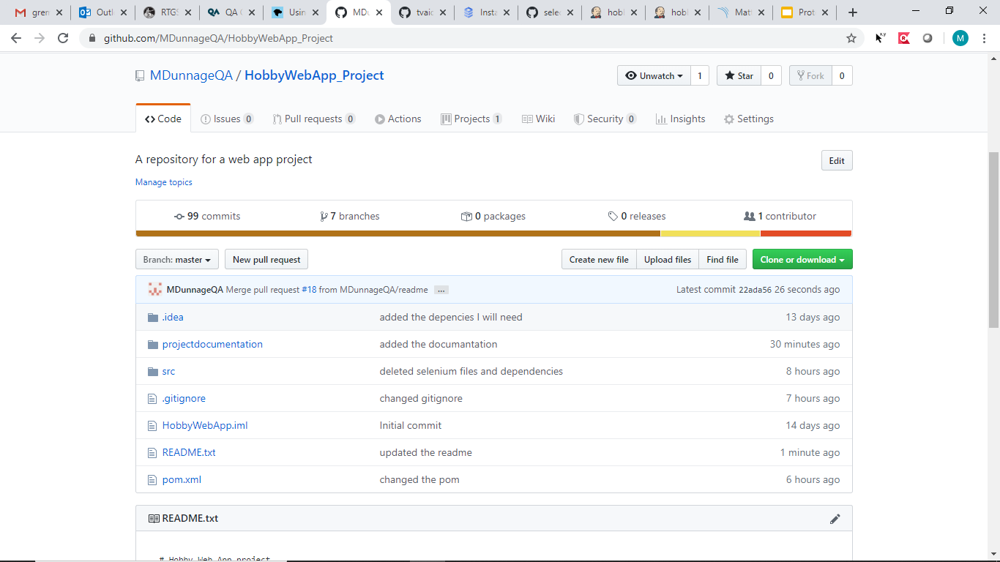
CI Pipeline - VCS
https://github.com/MDunnageQA/HobbyWebApp_Project

Slide 8
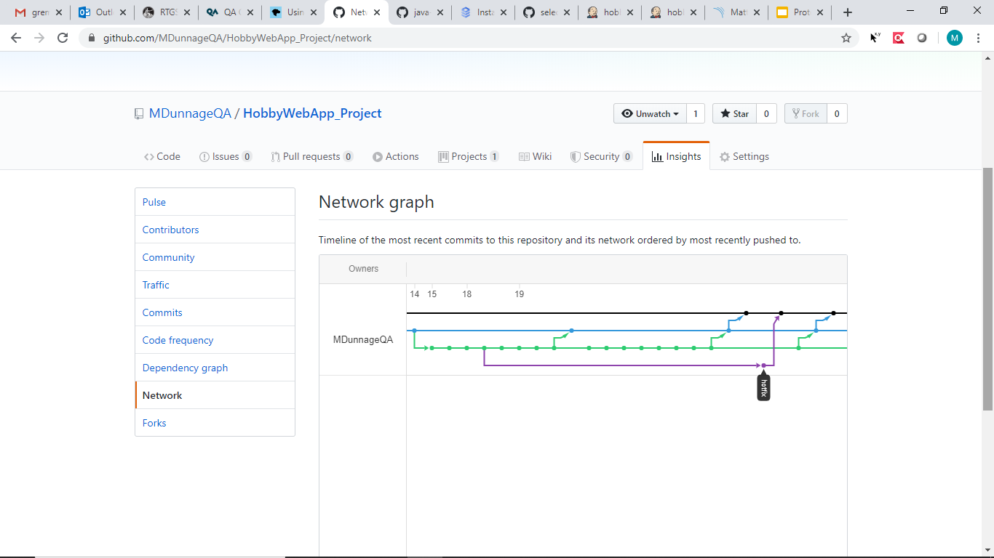
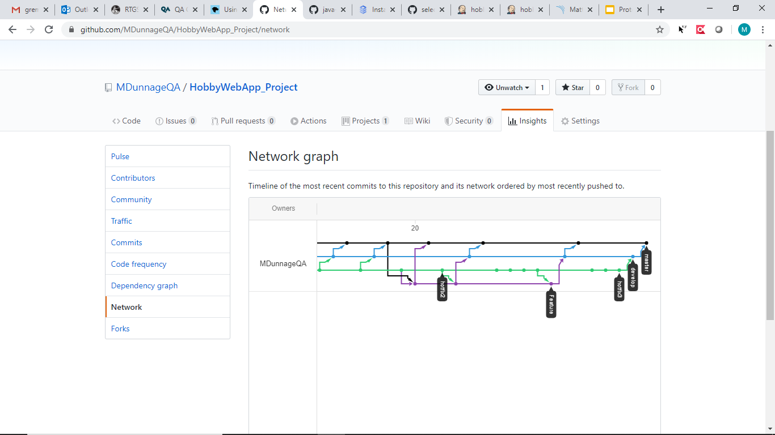
CI Pipeline - VCS
Network graph
Mostly used a feature develop branch model

Slide 9
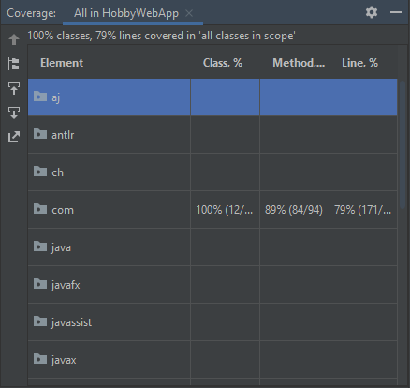
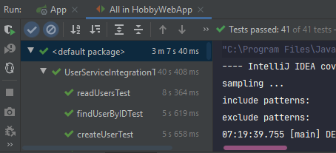
CI Pipeline - Unit/Integration Tests
Coverage = %79
41 / 41 tests pass

Slide 10
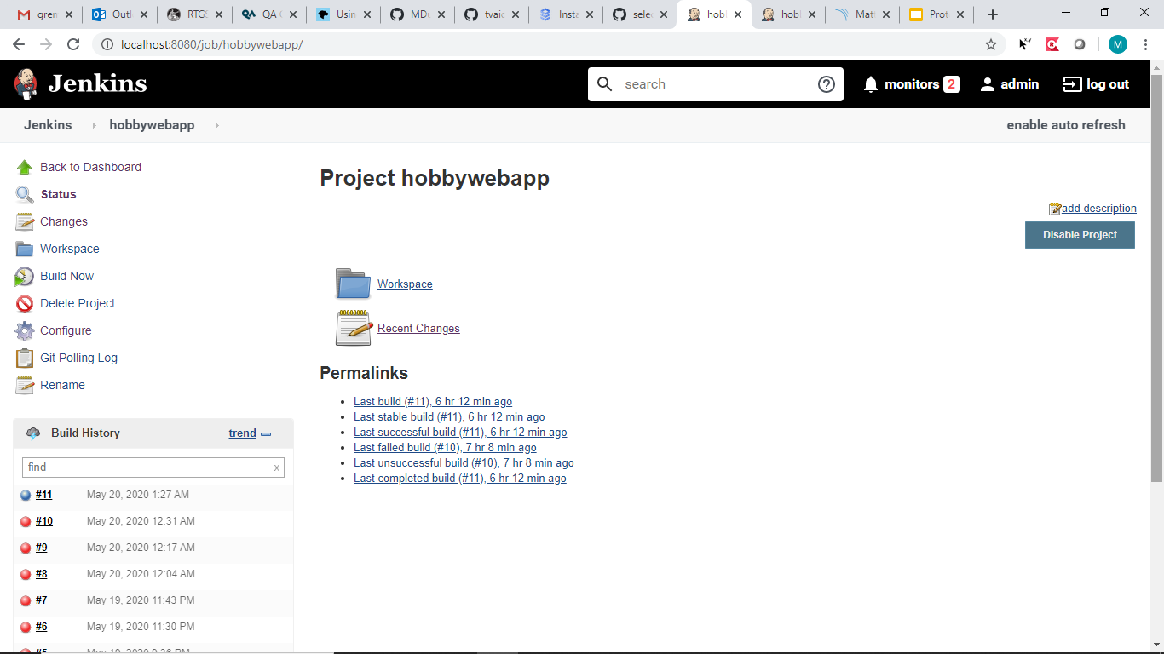
CI Pipeline - CI Server

Slide 11
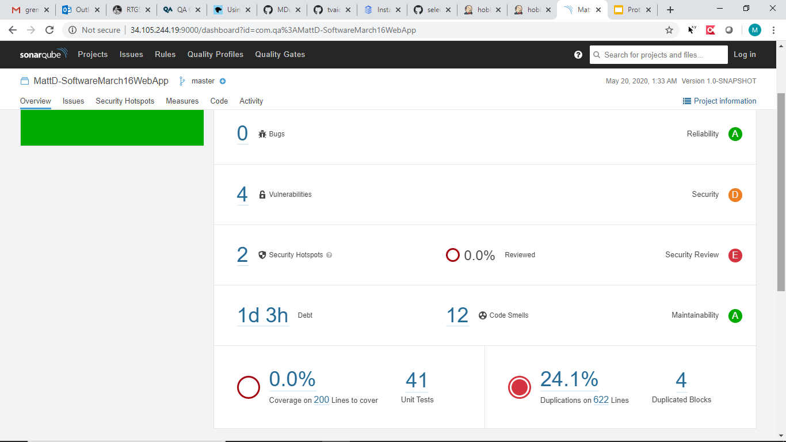
CI Pipeline - Static Analysis

Slide 12
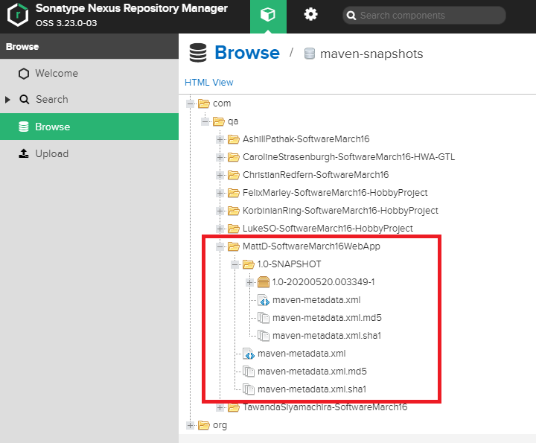
CI Pipeline - Artifact Repository

Slide 13
Demonstration

Slide 14
Reflection
What went well
Set realistic expectations
Very few issues with using Spring
Achieved all the must haves from my user stories board
What could be improved upon
Not use IntelliJ for merging branches
Find a better way to do Selenium testing
More time for Selenium testing

Slide 15
Questions?

